Slide 1


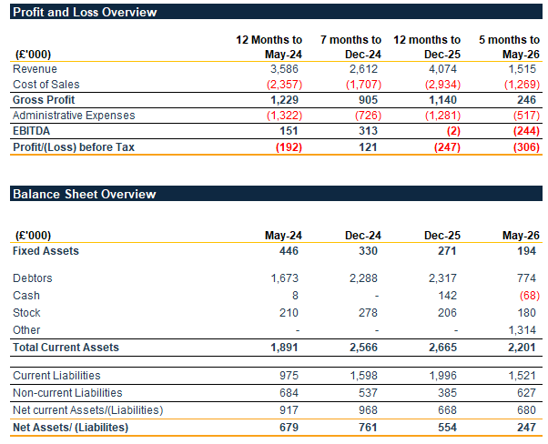
Acquisition opportunity
Project Waters
June 2026
Opportunity to acquire or invest in a market leading temporary 3D POS/POP specialist
Opportunity
Opportunity to invest in or acquire a well‑established provider of a temporary 3D point-of-sale / point-of-purchase (POS/POP) solutions, benefiting from a strong market presence, long‑standing customer relationships and proprietary product expertise.
The business delivers a comprehensive, end‑to‑end POS/POP offering, including design, prototyping, print, in‑house finishing, assembly, packing, delivery and fulfilment solutions.
Currently operating at 70% capacity providing room for growth.
Offers are invited for investment into the business or for the purchase of the business and assets on an accelerated basis.
Key Business Highlights
Based in a leasehold manufacturing facility located in central UK, the Company serves a nationwide client base across diverse retail sectors, including a number of leading household brands.
A dedicated in‑house design team works closely with customers to develop bespoke, product‑specific display solutions, supporting strong levels of repeat business and long-standing client relationships.
High‑quality production capabilities, including advanced print and cutting technology, combined with an experienced and flexible workforce, enable consistently short lead times and reliable, shop‑floor‑ready products.
Skilled workforce of 32 full‑time employees, including a core of long‑serving and dependable production staff.
Established supply relationships with two of Europe’s largest paper and board manufacturers, supporting resilience against market volatility and pricing pressures.
Financial Statements
The tables below summaries the financial performance across the past three financial periods and current year to date.
Expressions of interest
Interested parties will be required to sign a non-disclosure agreement (NDA). Offers, alongside proof of funding, are required no later than 5pm on Tuesday 30 June 2026 with completion of a sale required soon thereafter.
Further information
Further information is available upon completion and return of a non-disclosure agreement (NDA), which is available on request. Enquiries should be directed in the first instance to:
Richard Temple
E: richard.temple@eddisons.com
Important notice
The information above has been supplied by our client and should not be relied upon as statements or representations of fact or warranties of any kind. BTG, its partners and employees shall not be responsible for any error, omission or misstatement. Neither we nor our client accept any responsibility whatsoever in respect of these particulars, which are simply offered as a general indication to parties who may be interested. This firm is not authorised under the Financial Services and Markets Act 2000 but we are able in certain circumstances to offer a limited range of investment services to clients because we are licensed by the Institute of Chartered Accountants in England and Wales. We can provide these investment services if they are an incidental part of the professional services which we have been engaged to provide.

